Slide 1
Clemson Tiger Tour
By: Hongda Li, Zian Chen
Instructor: Dr. Roy P. Pargas

Slide 2
Background
GPS
The Global Positioning System (GPS) is a space-based satellite navigation system.
GPS can provide users with location information.
Core Location Framework
The Core Location Framework is provided by iOS and can get users’ heading direction.
Geographical Distance
Geographical distance is the distance measured along the surface of the earth.

Slide 3
Motivation
Clemson Tiger Tour is an iOS application that the users can use as a tour guide when they are visiting Clemson University campus.
This application can display the name of buildings with labels on the screen when the user points the camera lens to the buildings. Detailed descriptions of that building would show up if the label of that building is clicked.
The labels will move together with the buildings no the screen when the user scans the landscape horizontally.
And it will also provide the user with a dynamic path guide via compass shown on the Clemson University campus map.

Slide 4
Approaches
GPS
Obtaining user’s location by GPS.
Core Location Framework
Obtaining user’s heading direction by Core Location Framework provided by iOS.
Geographical Distance
Computing the label’s position on the device screen based on Geographical distance.

Slide 5
Current Progress
Tracking user’s location using GPS.
Enabling camera view on mobile device.
Obtaining current heading direction information.
External database populated with initial data.
Display labels of buildings on the screen.
The label of the building can indicate the right position of that related building (This feature works much better now).
Show the distance between the user and each of the buildings.
Display information page of the selected label.
Display the position of the destination on a Google map.

Slide 6
Menu View

Slide 7
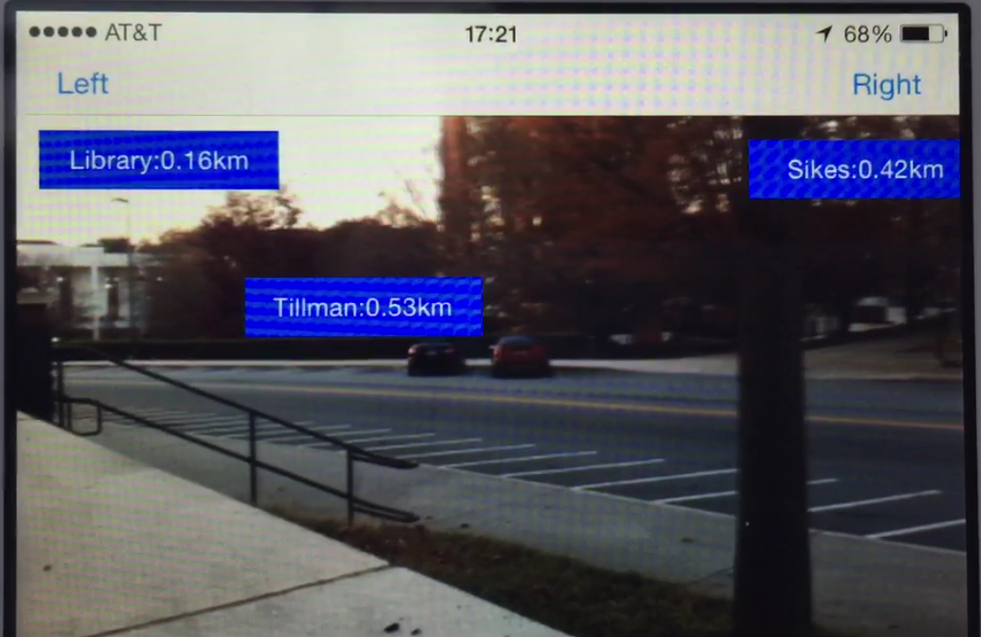
Camera Hunting View

Slide 8
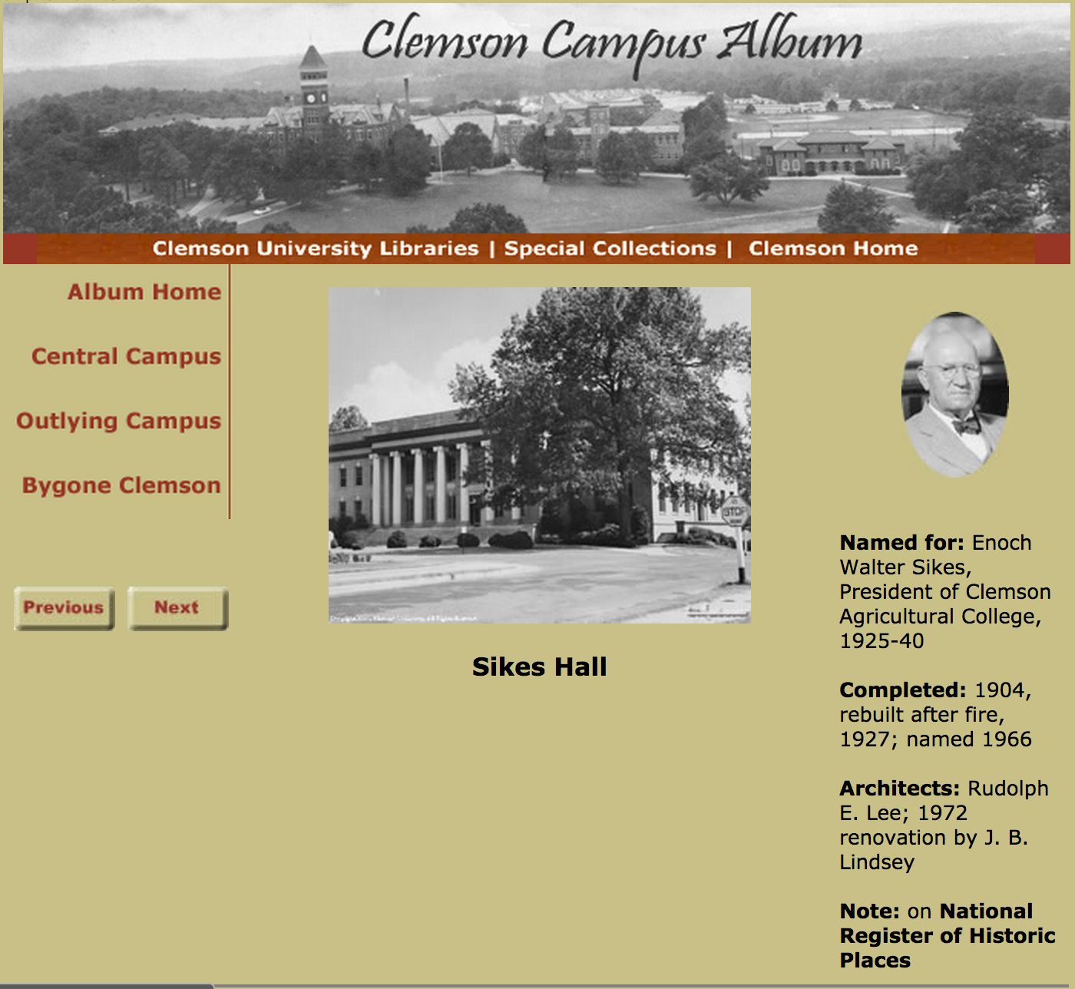
Sample info page on labels

Slide 9
Tiger Guide View

Slide 10
Future Plans
Change the background of labels.
Add 10 more buildings into our database.
Now the application shows the destination and the user’s location on the map. Next time we are going to display a compass on the map.

Slide 11
Acknowledgements
CoreLocation:
https://developer.apple.com/Library/ios/documentation/CoreLocation/Reference/CLLocationManagerDelegate_Protocol/index.html
Heading Direction:
http://stackoverflow.com/questions/7383589/compass-true-heading-in-iphone-ipad
Law of Cosines:
http://en.wikipedia.org/wiki/Law_of_cosines
Geographical Distance:
http://en.wikipedia.org/wiki/Geographical_distance

Slide 12
Thank You!

